Slide 1

My LifeForce Balance
Greens
MyLifeForceBalance.com

Slide 2

Greens Facts
Causes of majority of disease:
  Bad Digestive System
  Toxins
  Free Radicals
  Food
  Pollution
  Stress
  Lack of Sleep
  Acidity

Slide 3
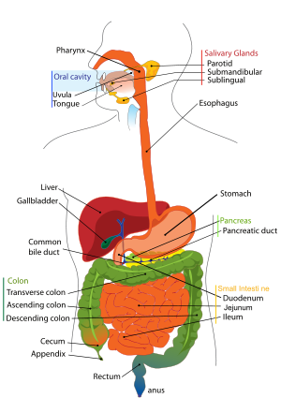
Bad Digestive System
Bad Digestive System Cause for majority of disease
Improper digestion of food leads to increased toxicity absorption
Left over food sticks to colon and releases toxins
High hormone levels released into blood via inability to digest
Leading cause of colon cancer
Decreased blood flow due to chemical ingestion

Slide 4
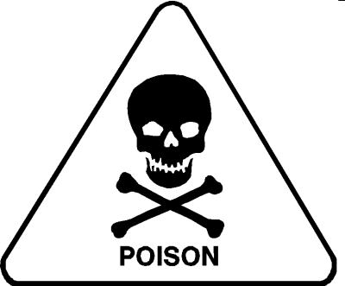
Toxins
Exposure to toxins is a major source of disease
Thousands of new chemicals are released into food chain and environment yearly
British Medical Journal estimates that 75% of cancers are caused by lifestyle and environment, mainly chemical exposure
Columbia University School of Public Health estimated 95% of cancer caused by food and environmental toxicity
Estimated 400 to 800 chemicals are stored in our bodies, many in fat cells
Toxins are in everything: food, air, and water

Slide 5
Toxins
Top 10 Toxins
Toxin | Risks | Major Sources
PCBs (polychlorinated biphenyls): This industrial chemical has been banned for decades, yet is a persistent organic pollutant that's still present in our environment. | Cancer, impaired foetal brain development | Farm-raised salmon. Most farm-raised salmon are fed meals of ground-up fish that have absorbed PCBs from the environment.
Pesticides: According to the Environmental Protection Agency (EPA), 60 percent of herbicides, 90 percent of fungicides and 30 percent of insecticides are known to be carcinogenic. In the U.S. pesticide residues have been detected in 50 percent to 95 percent of foods. | Cancer, Parkinson's disease, miscarriage, nerve damage, birth defects, blocking the absorption of food nutrients. | Food (fruits, vegetables and commercially raised meats), insect sprays
Mould and other Fungal Toxins: One in three people have had an allergic reaction to mould. Mycotoxins (fungal toxins) can cause a range of health problems with exposure to only a bit. | Cancer, heart disease, asthma, multiple sclerosis, diabetes. | Contaminated buildings, foods like peanuts, wheat, corn and alcoholic beverages
Phthalates: These chemicals are used to lengthen the life of fragrances and soften plastics. | Endocrine system damage (phthalates chemically mimic hormones and are particularly dangerous to children). | Plastic wrap, plastic bottles, plastic food storage containers. All of these can leach phthalates into our food.

Slide 6
Toxins
Top 10 Toxins
VOCs (Volatile Organic Compounds): VOCs are a major contributing factor to ozone, an air pollutant. VOCs tend to be even higher (two to five times) in indoor air than outdoor air, likely because they are present in so many household products. | Cancer, eye and respiratory tract irritation, headaches, dizziness, visual disorders, and memory impairment | Drinking water, carpet, paints, deodorants, cleaning fluids, varnishes, cosmetics, dry cleaned clothing, moth repellents, air fresheners.
Dioxins: Chemical compounds formed as a result of combustion processes such as commercial or municipal waste incineration and from burning fuels (like wood, coal or oil). | Cancer, reproductive and developmental disorders, endometriosis, chloracne, skin rashes, skin discoloration, excessive body hair, mild liver damage | Animal fats: Over 95 percent of exposure comes from eating commercial animal fats.
Asbestos: This insulating material was widely used from the 1950s to 1970s. Problems arise when the material becomes old and crumbly, releasing fibers into the air. | Cancer, scarring of the lung tissue, mesothelioma (a rare form of cancer) | Insulation on floors, ceilings, water pipes and healing ducts from the 1950s to 1970s.
Heavy Metals: Metals like arsenic, mercury, lead, aluminum and cadmium, which are prevalent in many areas of our environment, can accumulate in soft tissues of the body. | Cancer, neurological disorders, Alzheimer's disease, foggy head, fatigue, nausea and vomiting, decreased production of red and white blood cells, abnormal heart rhythm, damage to blood vessels | Drinking water, fish, vaccines, pesticides, preserved wood, antiperspirant, building materials, dental amalgams, chlorine plants.

Slide 7
Toxins
Top 10 Toxins
Chloroform: This colorless liquid has a pleasant, non-irritating odor and a slightly sweet taste, and is used to make other chemicals. It's also formed when chlorine is added to water. | Cancer, potential reproductive damage, birth defects, dizziness, fatigue, headache, liver and kidney damage.
Chlorine: This highly toxic, yellow-green gas is one of the most heavily used chemical agents. | Sore throat, coughing, eye and skin irritation, rapid breathing, narrowing of the bronchi, wheezing, blue coloring of the skin, accumulation of fluid in the lungs, pain in the lung region, severe eye and skin burns, lung collapse, reactive airways dysfunction syndrome

Slide 8
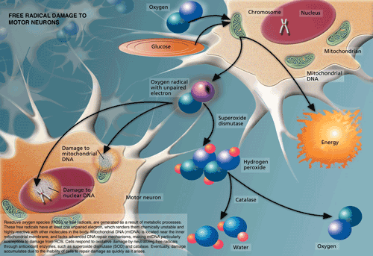
Free Radicals
What are they?
  Free Radicals are specific molecules which contain an odd number of electrons; thereby, they react with DNA, causing mutation and disease. Due to the innate weakness of free radicals, stemming from a missing electron, they are always searching for additional electrons. As a result, they attack the nearest molecule causing a chain reaction in the body.

Slide 9
Free Radicals
How do they damage the body?
Damage inside the body
  Damage cells, DNA, Lipid, sugar and protein
Leads:
  Deterioration of foods
  Cell Membrane dysfunction
  Protein modification
  Enzyme inactivation
  Break down of DNA strands
  Brain damage
  Dementia
Precursor to:
  Aging
  Cancer
  Heart Disease
  Diabetes mellitus
  Atherosclerosis
  Hypertension
  Sleep apnea
  Brain damage
  Alzheimer’s
  Parkinson’s

Slide 10
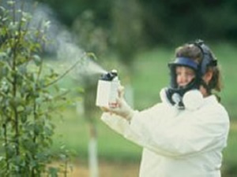
Free Radicals
Why?
During the last 50 years, advances in modern agriculture and food processing have almost eradicated most nutritional value from food - including vitamins, minerals and anti-oxidants. The use of toxic fertilizers lead to slippery slope of declining nutrition in the soil; therefore, causing plants to grow without producing anti-oxidants, vitamins or minerals.

Slide 11
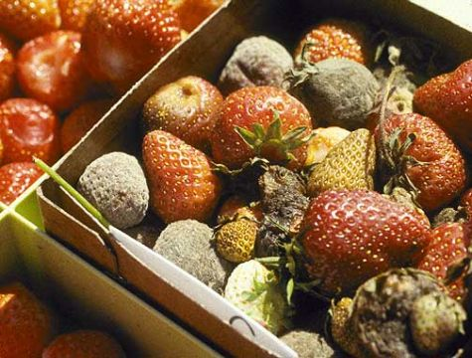
Food
Meat filled with Growth Hormone, Anabolic Steroids, Anti-Biotics, Anti-Fungals, Stimulants, Insulin, and IGF-1 Growth factors
Fish filled with PCBs, dioxins, heavy metals, pollution and toxic waste
Fruits and vegetables full of pesticides, herbicides, fungicides, insecticides and heavy metals

Slide 12
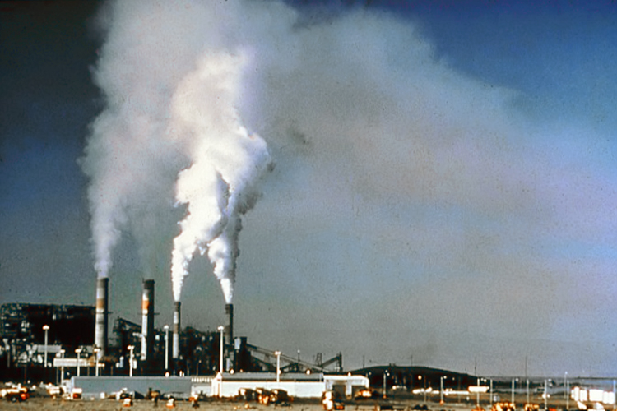
Pollution
Arsenic poisoning:
  Nerve Damage
  Skin Damage
    HyperKeratosis (scaling skin)
    Pigment changes
Increased Cancer Risk:
  Lung
  Bladder
  Kidney and Liver cancers
Circulatory problems in Skin:
  Poor circulation of blood
Lead Poisoning:
  High Levels of Lead
    Mental Retardation, Coma, convulsions and death
  Low Levels of Lead
    Reduced IQ and attention span (ADD), impaired growth, reading / learning disabilities, hearing loss and many other health problems

Slide 13

Stress
Brain
  Surge of hormones causes hyped state, hard to relax or sleep
  Hormone rushes and exhaustion cause irritability, aggression, inability to concentrate, headaches and memory loss
  Prolonged stress periods can lead to depression, suppression of hypothalamus and decrease in endorphins
Lungs
  Stress causes hyperventilation - part of fight-or-flight. This can aggravate asthma and increase respiratory problems
Heart
  During times of stress, blood flow increases - as blood is pumped faster and harder. The boost in blood pressure happens due to the release of epinephrine as well as cortisol, which leads to palpitations and chest pains (possible heart attack/stroke).
  In Individuals with genetic predisposition to heart problems, stress can thin the blood, preventing it from clotting properly, which stimulates the formation of plaque in arteries. Research has shown a direct correlation between stress and hypertension (high blood pressure).

Slide 14
Stress
Immune System
  Constant stress lowers overall white blood cell count, which leads to disease and drop in immune functions.
  Studies have shown some vaccines are less effective in people with high stress levels
  Research has linked stress to autoimmune disease like Graves, where antibodies attack thyroids, eyes, muscles and skin
Digestive System
  During stress the brain will shift blood from the digestive tract, slowing digestion
  Poor circulation in the digestive system can cause diarrhea, constipation, indigestion, ulcers, and colon cancer
  Irritable bowel syndrome, has been linked to high stress levels by many researchers
Skin
  Stress boosts hormone release that cause acne, itchy/dry skin and rashes
  Extreme cases of stress have been known to cause hives and wrinkles
Hair
  During stress the body increases the breakdown of nutrients like selenium, which can lead to premature graying. Long term stress pressures can cause the immune system to attack hair follicles, causing hair loss.
Hearing
  Increased hormone levels improve hearing;
  Cornell University concluded sensitive (increased) hearing capacity adds small noise stressors (ringing phones , car horns etc...) to the overall stress, boosting stress levels higher

Slide 15

Lack of Sleep
Leads to developments of diabetes
University of Buffalo study (2009) discovered that sleeping less then 6 hours per night increased fasting glucose levels 5 fold
Long term exposure to lack of sleep increases risk of mental illness
Problems with memory, and constant memory loss
Cleveland Clinic discovered constant insomnia was linked to a drop in immunity (immune system failure)

Slide 16
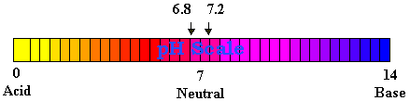
Acidity
Body PH balance too acidic causes body to work overtime to neutralize the acidity and bring balance
The nutrients required for balancing your body are taken from your brain, heart, bones, liver, lungs, muscles, skin and all other parts of the body
Due to mass production of food, nutrient values have plummeted, reducing/eliminating most nutrients needed to balance your body
New York Dr. William Howard Hay, published groundbreaking scientific information concluding that majority of disease are caused by auto-toxication
Dr. Theodore A. Baroody provided scientific evidence that the root cause of many diseases are from high acidity levels in the body, and added that even mild acidosis can cause kidney problems, gallbladder failure and cardiovascular damage

Slide 17
Greens Benefits
Digestive System (Internal) - Probiotics
Probiotics clean the intestinal tract. They penetrate under the layer of rotten fecal matter on the intestinal walls, break down the bonds and dislodge the decay. This allows the waste to flush naturally
When attached to the intestinal walls, probiotics produce an environment which slows growth of disease-causing (bad) bacteria.
Constipation is relieved via probiotic use since bowel movements are normalized.
The production of the antigen proteins allows for a reservoir of nonspecific antigens to be used by the immune system - easier to fight disease
Working in a symbiotic relationship with organs and tissues, they metabolize proteins and help eliminate toxic waste from body
Probiotics stimulate B-Lymphocyte and other anti-body production, producing huge amounts of excess anti-bodies to be used by the body to defend against infections and disease
They help kill viruses and parasites, improving health benefits
Lower Cholesterol, allergies and skin problems are near eliminated with probiotics
Probiotics prevent and eliminate many yeast and fungal infections
Probiotics stimulate production of alpha-interferon, an immune response regulator

Slide 18
Greens Benefits
Digestive System (Internal) Digestive Enzymes
Digestive enzymes aid in the breakdown of food into smaller particles. While the body naturally produces digestive enzymes, it often lacks the needed production capacity required for proper digestion.
Circulation - prevent excessive blood clotting and reduces platelets ability to stick
Inflammation - enzymes are essential for the repair of tissues. Reduced swelling, pain and increased recovery.
Overall Health - vital to proper autoimmune conditions, chronic disease and arthritis
Break down fats - digestive enzymes take stress off the gall bladder, liver, and pancreas.
Endorine system - lack of digestive enzymes, causes a slowing/failure of the endocrine system, which slows the metabolic rate
Mental Capacity - hypothalamus directs endocrine system, and balances emotions (chemical balances in the brain).
Skin - Researchers have concluded enzymes slow and reverse the aging process via increased supply of blood to the sking, which brings nutrients and carries away waste from the skin

Slide 19
Greens Benefits
Digestive System (Internal) Dietary Fibers
Reduces appetite by adding bulk to diet and increase full feeling
Lowers blood sugar levels by trapping carbohydrates and slowing absorption of glucose
Reduces risk of heart disease by lowering total and LDL cholesterol levels
Reduced risk of colorectal cancer by balancing intestinal pH and stimulating intestinal fermentation production of short-chain fatty acids
Increases regularity and alleviates constipation by speeding passage of food and adding proper bulk
Irritable bowl syndrome (IBS), causes gas, constipation, abdominal pain, cramping, diarrhea and bloating. IBS directly correlated to poor dietary habits, anxiety, medication and stress. Proper fiber intake along with other digestive aids such as probiotics and digestive enzymes, aid in curing IBS.

Slide 20
Greens Benefits
Body Overall (External) – AntiOxidants
Antioxidants slow down or stop oxidation - chemical reaction involving uptake of oxygen , and production of free radicals
Antioxidants mop up oxygen-containing free radicals and removes them before damage is done
Antioxidants produce a stronger immune system - a resistance to infections, viruses and flues
Decrease cholesterol problems and lower risk of heart disease
Reduced possibilities of all cancers
Natural Anti-aging of cells, including skin, organs and body

Slide 21
Greens Benefits
Body Overall (External) – Vegetables, Fruits, Berries, Grasses, Extract Mix
Over the centuries the use of natural fruits, vegetables, and grasses have been a staple of healthy bodies
Risk of breast cancer among Japanese women (post-menopausal) was reduced close to 40% due to increased fruit intake
A study in Finland, on males of 37-45 (middle age) concluded that high consumption of fruits, berries, and vegetables lead to a 41% reduction in cardiovascular disease caused deaths, and a 34% reduced chances of death from all causes
Blueberries are known to contain potent anti-aging properties
In recent studies, concord grapes have showed to improve short-term memory and motor skills. In addition, concord grapes have shown a strong capacity to slow down or, in some cases, prevent mental and physical declines which come with natural aging
Cranberries are a rich source of proanthocyanidins, which protect the body against cancer and heart disease, and help fight urinary tract infections
Scientists show that Cruciferous vegetables (such as broccoli, brussel sprouts and cauliflower) prevent cataract formation, act as an effective anti-obesity agent, protect your cardiovascular system, and protect against cancer
Clinical data demonstrates that the consumption of barley (barley grass) is effective for lowering total and LDL cholesterol

Slide 22
Costs vs. Benefits
The USDA and the US Department of Health and Human services recommend 4 servings of fruits per day, along with 5 servings of vegetables per day. That is a bare minimum.
Branches of scientists have suggested at least 6 servings of fruits and 8 servings of vegetables per day, adding at least 1 to 2 cups of berries daily.

Slide 23
Costs vs. Benefits
6 Sample fruits, berries:
(1 serving each/day)
Blueberries –
$5.99 USD/pack - $2 USD/serving
Cranberries – (not fresh!) –
$4.99 USD/pack - $1.20 USD/serving
Cherries –
$4.99 USD/pack - $1.18 USD/serving
Raspberry –
$4.99 USD/pack - $1.10 USD/serving
Plums - (not fresh!) –
$4.49/pack - $1.05 USD/serving
Grapes –
$1.99 USD/pack - $0.45 USD/serving
Fruits/Berries 1 day minimal intake:
$6.98 USD/day
HKD equivalent $6.98 USD = $54.44 HKD
6 Sample Vegetables:
(1 serving each/day)
Broccoli –
$2.99 USD lb. - $0.50 USD/serving
Cauliflower –
$1.49/head - $0.35 USD/serving
Brussel Sprouts –
$3.99 USD lb. - $0.75 USD/serving
Carrots –
$1.99 USD/pack (8oz) - $0.50 USD/serving
Spinach –
$7.99 USD lb. - $1.10 USD/serving
Parsley –
$0.69/pack - $0.12 USD/serving
Vegetables 1 day minimal intake:
$3.32 USD/day
HKD equivalent $3.32 USD = $25.89 HKD

Slide 24
Costs vs. Benefits
6 Sample fruits, berries:
(1 serving each/day)
Fruits/Berries 1 day minimal intake:
$6.98 USD/day
HKD equivalent $6.98 USD = $54.44 HKD
6 Sample Vegetables:
(1 serving each/day)
Vegetables 1 day minimal intake:
$3.32 USD/day
HKD equivalent $3.32 USD = $25.89 HKD
6 fruits/berries + 6 vegetables (12 ingredients)
$10.01 USD per day = $80.33 HKD/day
GREENS (Over 50 ingredients)
$1.92 USD per day = $14.99 HKD/day
+NET SAVINGS+
$8.09 USD per day = $65.34 HKD/day

Slide 25
Costs vs. Benefits
6 fruits/berries + 6 vegetables
(12 ingredients)
$10.01 USD per day = $80.33 HKD/day
12 ingredients, just fruits and vegetables
GREENS (Over 50 ingredients)
$1.92 USD per day = $14.99 HKD/day
+NET SAVINGS+
$8.09 USD per day = $65.34 HKD/day
With GREENS you don’t just get Fruits and Vegetables. You also get:
Probiotics
Digestive Enzymes
Dietary Fiber
Grasses
Omega fats
Extra Fruits/Berries, Vegetable
Numerous Extracts

